Slide 1


2
3
1
ENERGY CONSUMPTION ACROSS BORDERS
GitHub & Git
Queries
Tables
Describe GitHub’s role in our project and its use for teamwork.
Explain Git‘s core features and how we used it
Discover how we structured and connected our tables to analyze energy trends and global data relationships.
Present SQL queries for data analysis. Explain their goals and highlight key results

Slide 2
1
2
3
GitHub & Git
Tables
Queries
Describe GitHub’s role in our project and its use for teamwork.
Explain Git‘s core features and how we used it
Discover how we structured and connected our tables to analyze energy trends and global data relationships.
Present SQL queries for data analysis. Explain their goals and highlight key results

Slide 3
1
GitHub & Git
Describe GitHub’s role in our project and its use for teamwork.
Explain Git‘s core features and how we used it

Slide 4
What is GitHub?
Web-based platform:
Version control
Collaboration
GitHub combines these two features to enhance teamwork and code management.

Slide 5
Why GitHub was essential
Efficient collaboration
Traceability
Transparency
These features are powered by Git, the version control system.

Slide 6


What is Git?
Functions:
Tracks changes in files
Allows you to load previous versions
Supports branching and merging

Slide 7
How did we use Git?
Clone Repository
Creating Branches
Commit and Push changes
Pull Requests and Merge

Slide 8
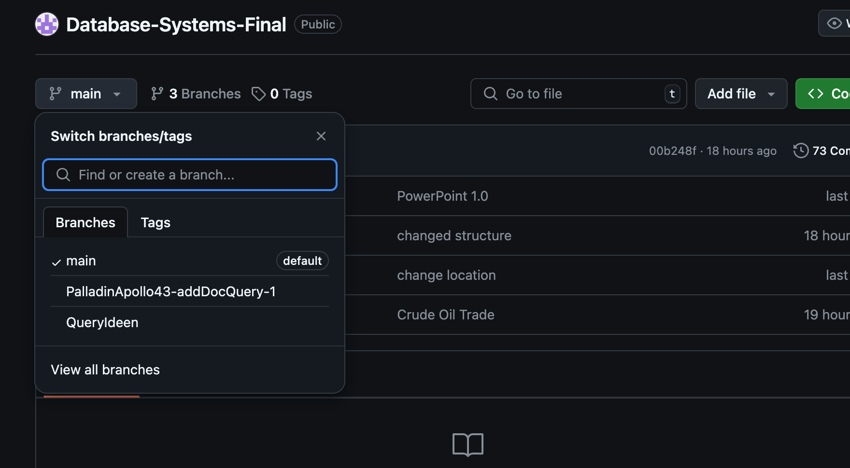
Example for Branches

Slide 9
How did we use Git?
Clone Repository
Creating Branches
Commit and Push changes
Pull Requests and Merge

Slide 10
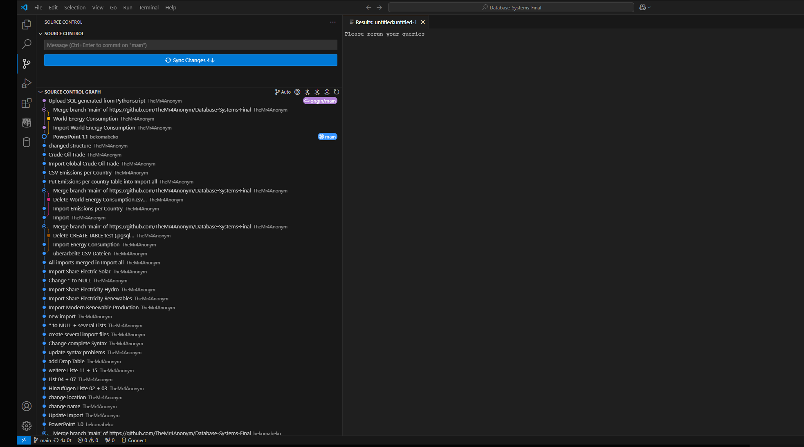
Example for Commits

Slide 11
How did we use Git?
Clone Repository
Creating Branches
Commit and Push changes
Pull Requests and Merge

Slide 12
2
Tables
Discover how we structured and connected our tables to analyze energy trends and global data relationships.

Slide 13




HOW CAN WE IDENTIFY THE GLOBAL TRENDS IN RENEWABLE ENERGY?

Slide 14


WE NEED A SOURCE/DATASET
They need to be:
robust
diverse
useful
kaggle.com

Slide 15



HOW CAN TABLES HELP US ABOUT ENERGY CONSUMPTION AND WHY DID WE CHOOSE THEM?

Slide 16
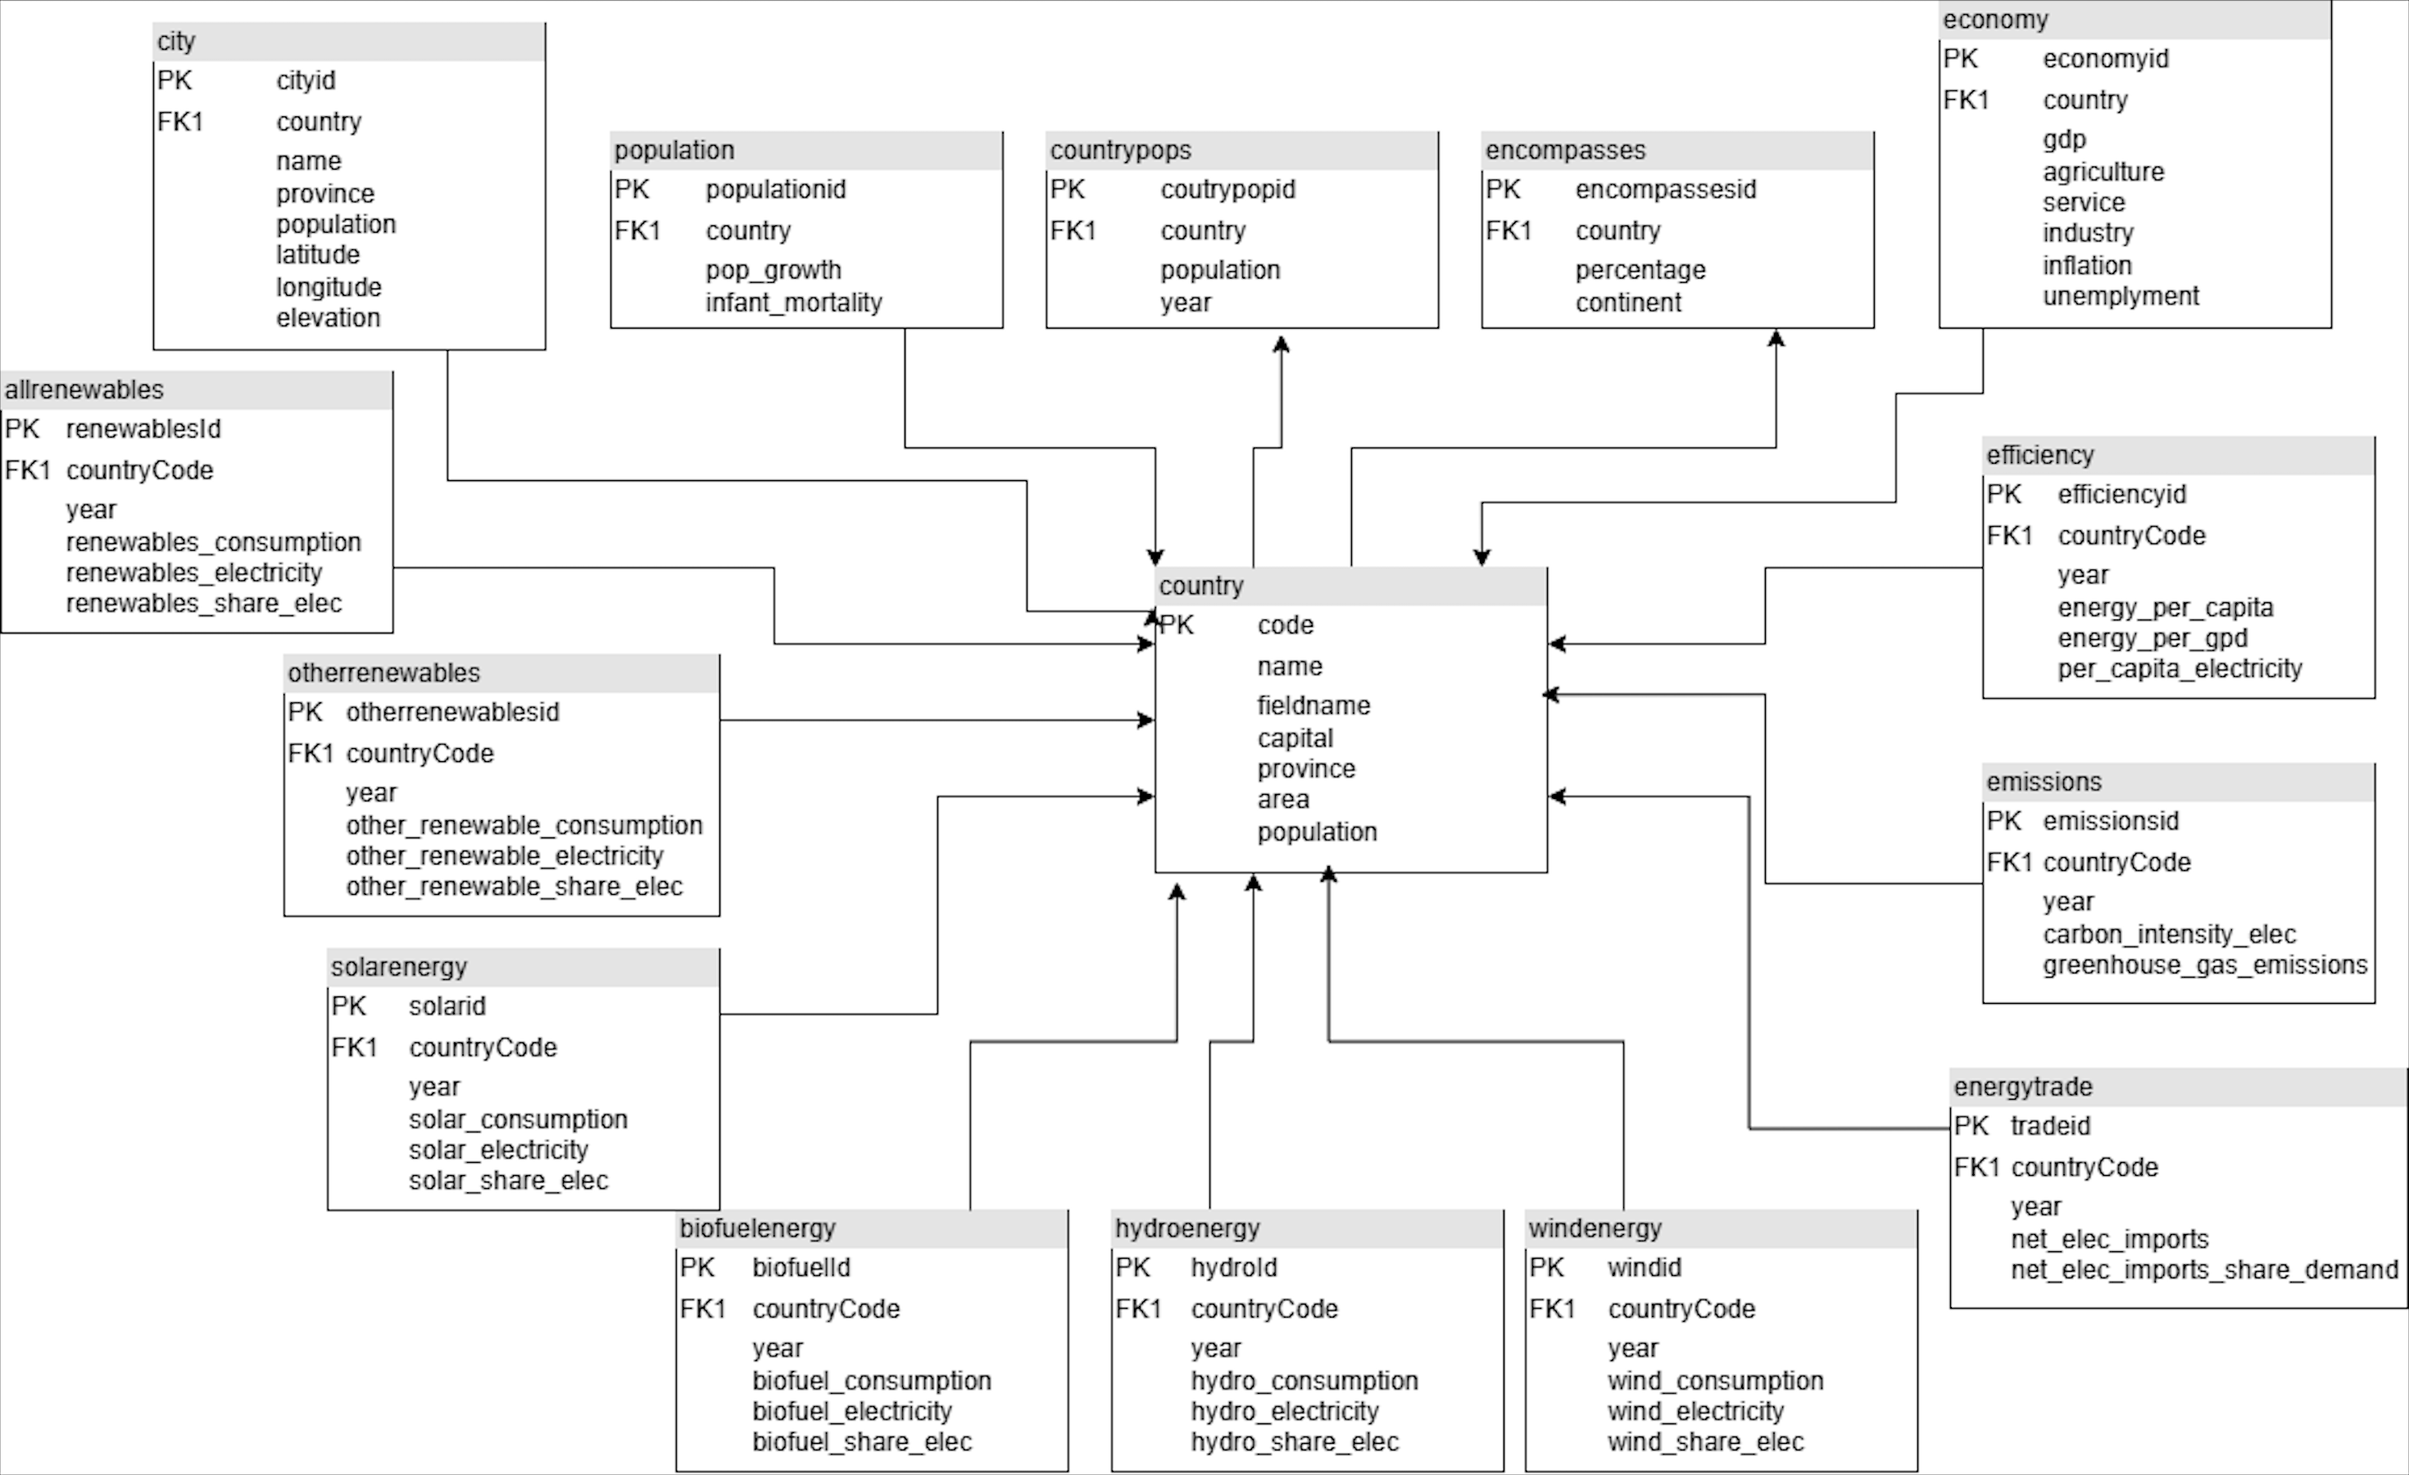
mondial
main table
renewables
energy types
environment

Slide 17
3
Queries
Present SQL queries for data analysis. Explain their goals and highlight key results

Slide 18
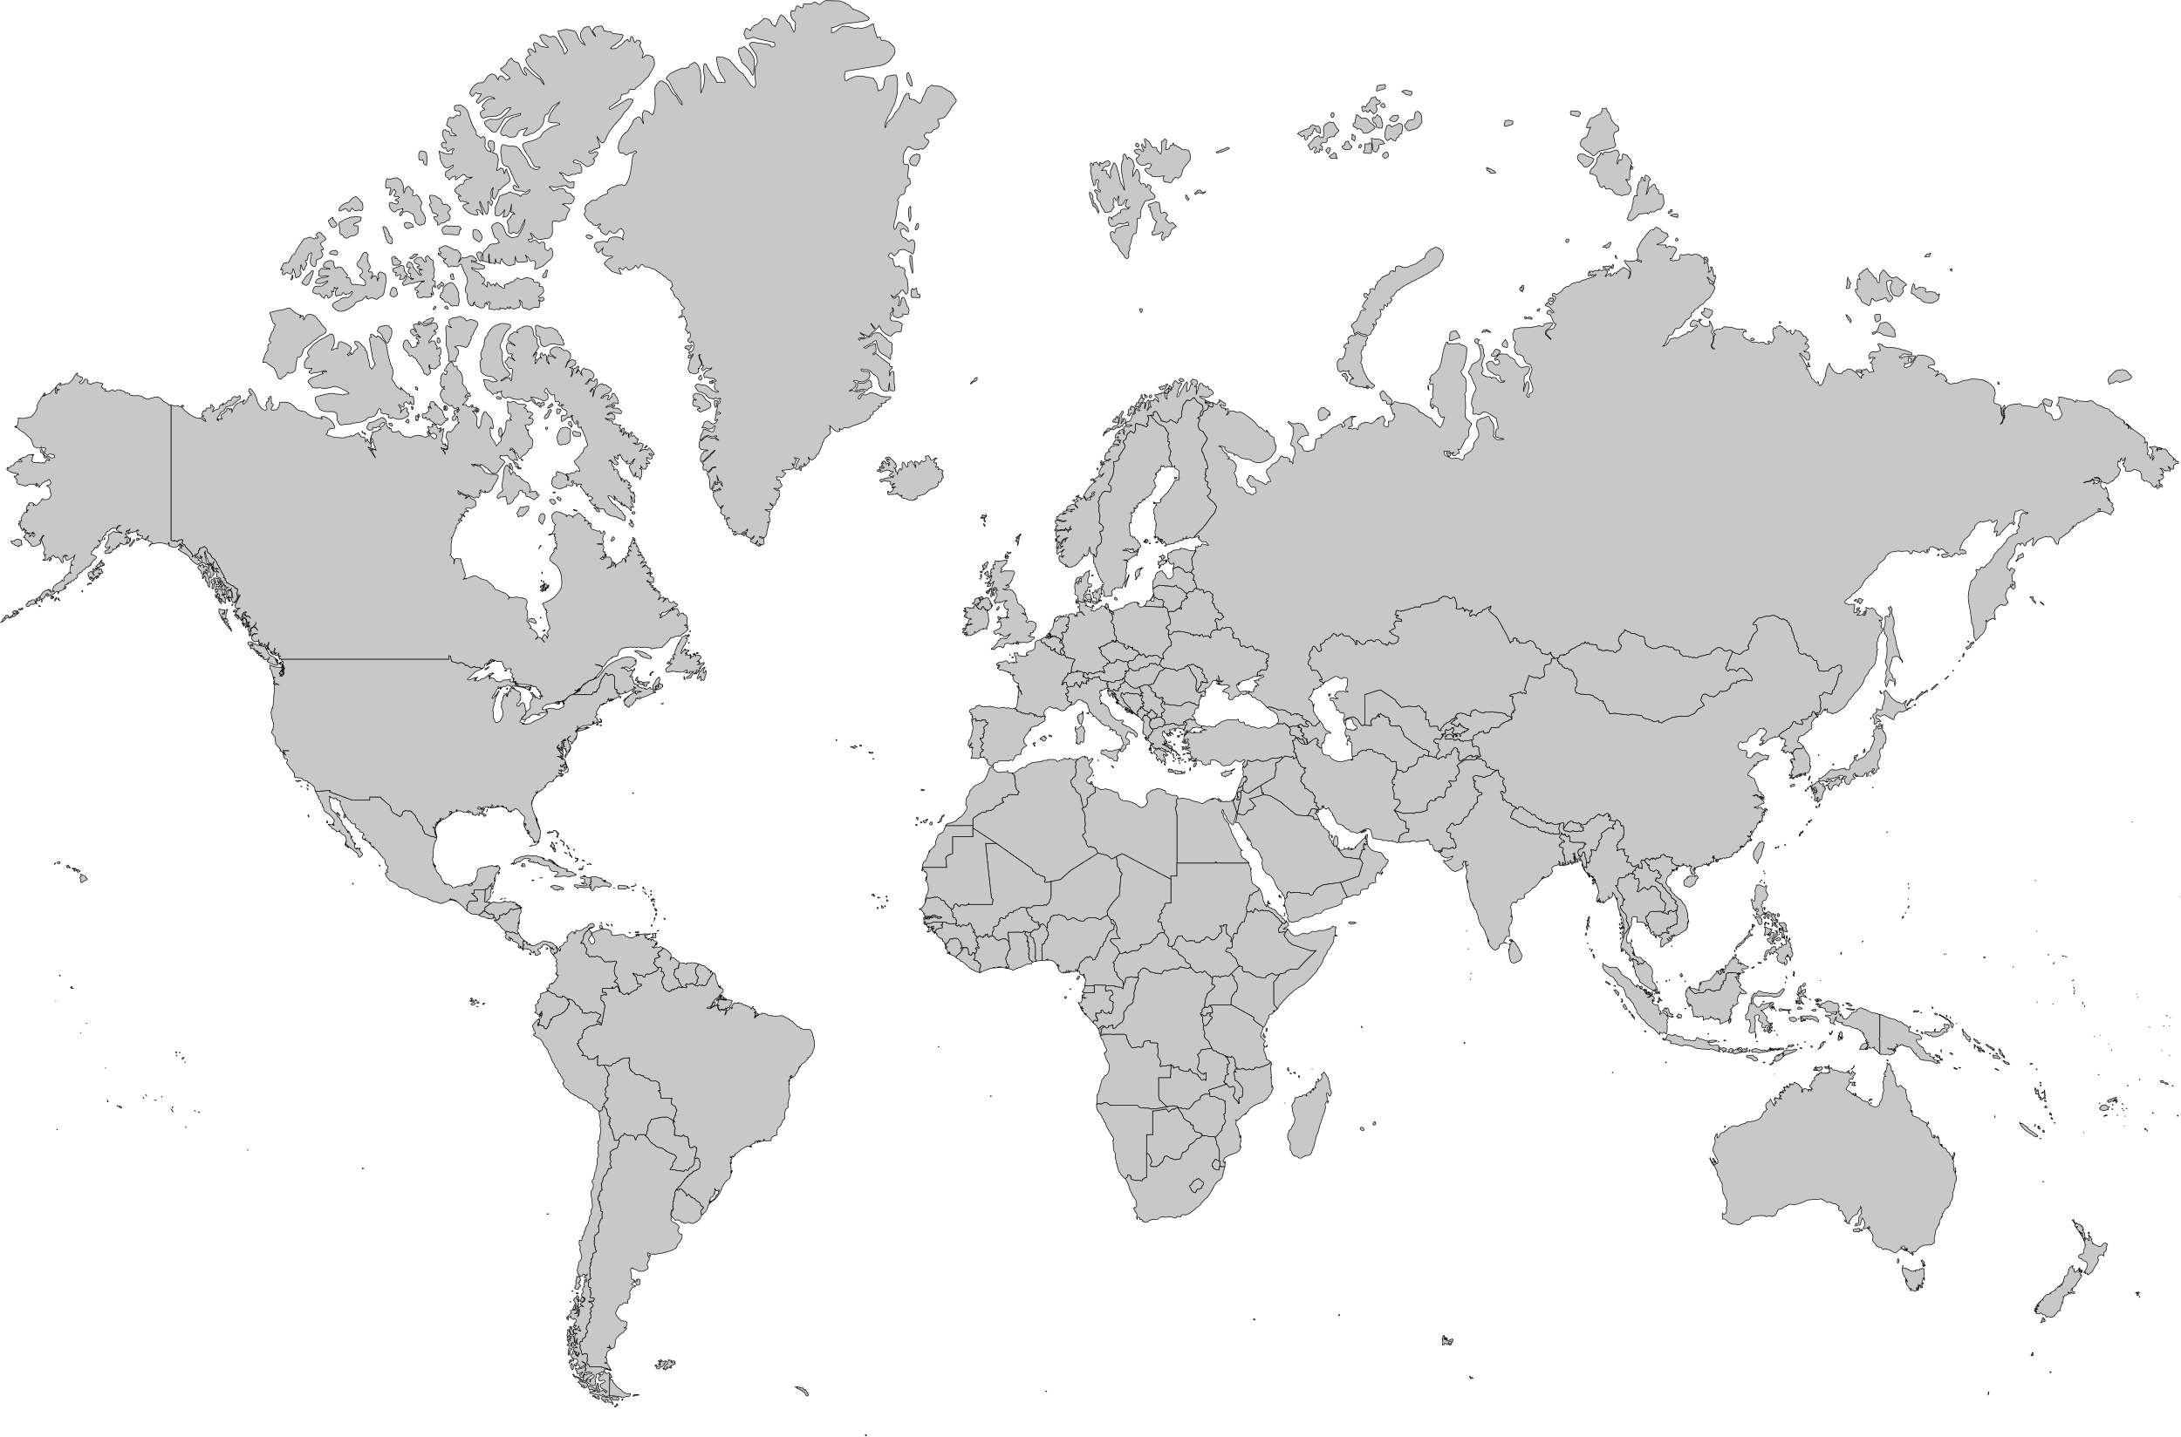

Slide 20

Thank You!

